Slide 1
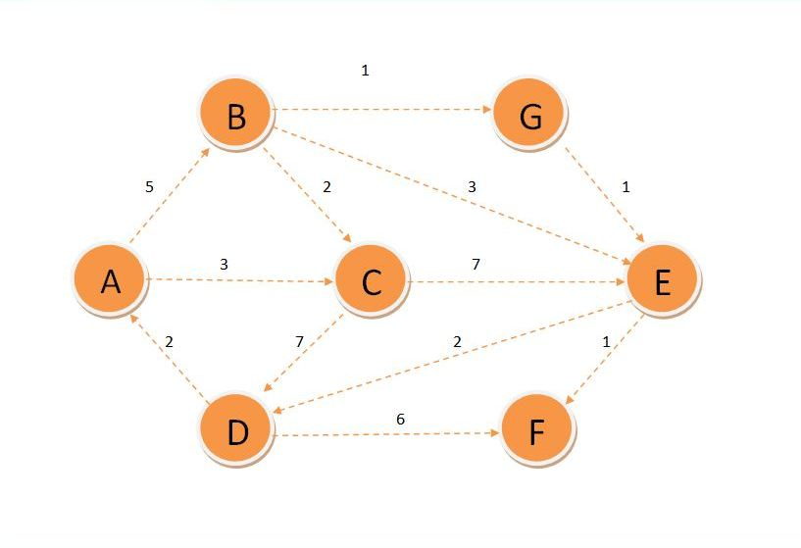
PARENT |  | A | A | E | G | E | B
# | A | B | C | D | E | F | G
 | 0 | - | - | - | - | - | -
 |  | 5 | 3 | - | - | - | -
 |  | 5 |  | 10 | 10 | - | -
 |  |  |  | 10 | 8 | - | 6
 |  |  |  | 10 | 7 | -
 |  |  |  | 9 |  | 8
 |  |  |  | 9

Slide 2
ABG = 6
ABGEF = 8
ABGE =7
ABGED=9
AC = 3
AB = 5

